Slide 1

Shell Scripting

Slide 2

Agenda
Introduction
Additional Tools
Shell Scripting
Getting started with Shell Scripting

Slide 3

Introduction
What is Shell Scripting?
A shell script is a computer program designed to be run by the Unix/Linux shell.
A shell is a command-line interpreter and typical operations performed by shell scripts include file manipulation, program execution, and printing text.
Uses of Shell Scripting
Task Automation – It can be used to automate repetitive tasks like regular backups and software installation tasks.
Customization – One can use shell scripts to design its command line environment and easily perform its task as per needs. File
Management – The shell scripts can also be used to manage and manipulate files and directories, such as moving, copying, renaming, or deleting files.

Slide 4

Shell Scripting Introduction
Let’s Dive In

Slide 5

Initialization
Step 1 Create a file with .sh extension.
Step 2 Give the executable permissions
chmod +x filename.sh
Step 3 Change the directory to the location of the file.
Step 4 Create your required script using any editor like VS Code, Vim editor, nano editor, etc and save it.
Step 5 To run the script run the following command in the terminal
./filename.sh

Slide 6
Points to Remember
Bash is the most commonly used shell program. It stands for Bourne-Again Shell.
To check the type of shell our operating system supports enter the following line
cat /etc/shells
To see where our bash is located use
which bash
Always enter “#! /bin/bash” before writing our script to instruct the operating system to use bash as a command interpreter.
# is used for writing comments which can be helpful for understanding any line.
The default variable into which our input goes is the REPLY variable.
$ is used to indicate a variable. It is written as follows
$REPLY
$@ stores the argument as an array.
$# prints the number of arguments.
For debugging we can use
bash –x filename

Slide 7
Shell Scripting
Integer Comparison
-eq is for equal to -> if [ “$a” -eq “$b” ]
-ne is for not equal to -> if [ “$a” -ne “$b” ]
-gt is for greater than -> if [ “$a” -gt “$b” ]
-ge is for greater than or equal to -> if [ “$a” -ge “$b” ]
-lt is for lesser than -> if [ “$a” -lt “$b” ]
-le is for lesser than or equal to -> if [ “$a” -le “$b” ]
< is for lesser -> (( “$a” < “$b” ))
<= is for lesser than or equal to -> (( “$a” <= “$b” ))
> is for greater than -> (( “$a” > “$b” ))
>= is for greater than or equal to -> (( “$a” >= “$b” ))

Slide 8
Shell Scripting
String Comparison
= / == is for equal to -> if [ “$a” = “$b” ] (or) if [ “$a” == “$b” ]
!= is for not equal to -> if [ “$a” != “$b” ]
< is for less than in ASCII alphabetical order -> if [ “$a” < “$b” ]
> is for greater than in ASCII alphabetical order -> if [ “$a” > “$b” ]
-z is string is null, that is, has zero length.

Slide 9
Shell Scripting
Tags
-e -> to use \c in a line.
-> To find a file.
-f -> To find a regular file or check whether it is a regular file or not.
-d -> To find a directory or check whether it is a directory or not.
-a -> To read all the variables being entered.
-b -> For block Special file.
-c -> For Character Special file.
-s -> Whether a file is empty or not.
-r, -w, -x -> For Read, Write and Execute permissions respectively.

Slide 10
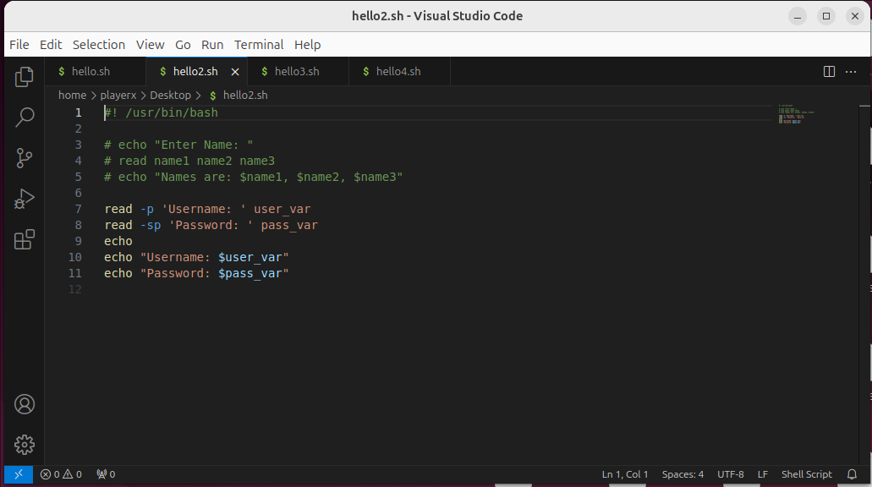
Shell Scripting
echo is used to display text whereas read is used to take in input from the user.
To display a line and also read the input in the same line we can use
read -p ‘ The text comes here ’ var_name
To hide the input being entered in the terminal add an s before p as shown
read -sp ‘ The text comes here ’ var_name

Slide 11

Shell Scripting
Let’s Dive In

Slide 12

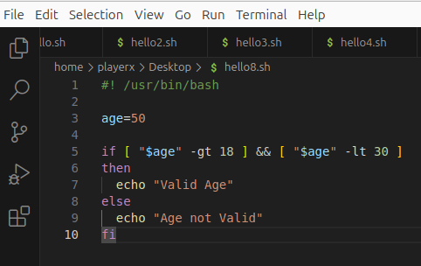
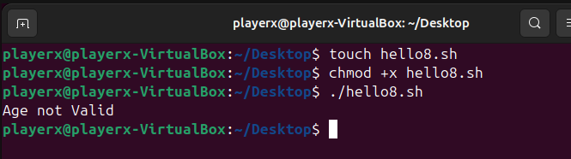
Shell Scripting
AND operator
AND can be used by the following command lines:
[ ____ ] && [ ____ ] or [ ____ -a ____ ] or [[ ____ && ____ ]]

Slide 13

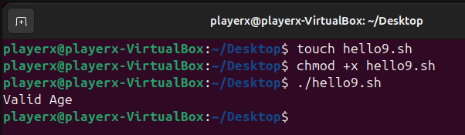
Shell Scripting
OR operator
OR can be used by the following command lines:
[ ____ ] || [ ____ ] or [ ____ -o ____ ] or [[ ____ || ____ ]]

Slide 14
Shell Scripting
Some useful operators for Shell Scripting:
While -> while [ condition ]
do
commands
done
If then, if then else, if then elif else -> if [ condition ]
then
statement
fi
Case -> case expression in
pattern1 )
statements ;;
…
esac

Slide 15
Shell Scripting
Until -> until [ condition ]
do
commands
done
For -> for VARIABLE in { Start .. End .. Increment }
do
command
done
Select -> select varName in list
do
command
done

Slide 16
Shell Scripting
IFS
The shell has one environment variable, which is called the Internal Field Separator (IFS).
This variable indicates how the words are separated on the command line.
IFS defaults to a space, tab, and newline character, which means that, by default, fields in a string are separated by any combination of these characters.
However, the IFS value can be changed to meet the specific needs of a script by using the following line:
$ IFS=“required character”

Slide 17
Shell Scripting
Signals and Traps
The trap command in Bash executes specific code in response to the signal given to the program. It traps the signal received by the program from the OS or the user and then executes the specific code provided by the programmer. It acts like a trigger in response to a signal.
Commonly used Signals:
Signal | Description
SIGINT (2) | Interrupt signal, typically sent when pressing Ctrl+C.
SIGTERM (15) | Termination signal, often used for stopping processes gracefully.
SIGKILL (9) | Kill signal that forcefully terminates a process (cannot be trapped).
SIGTSTP (20) | Stop signal, sent by pressing Ctrl+Z.
EXIT (0) | A pseudo-signal received when the script exits.

Slide 18
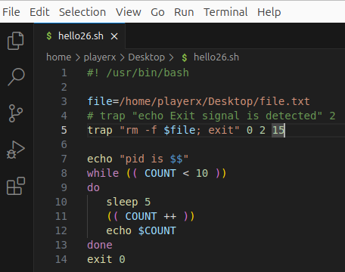
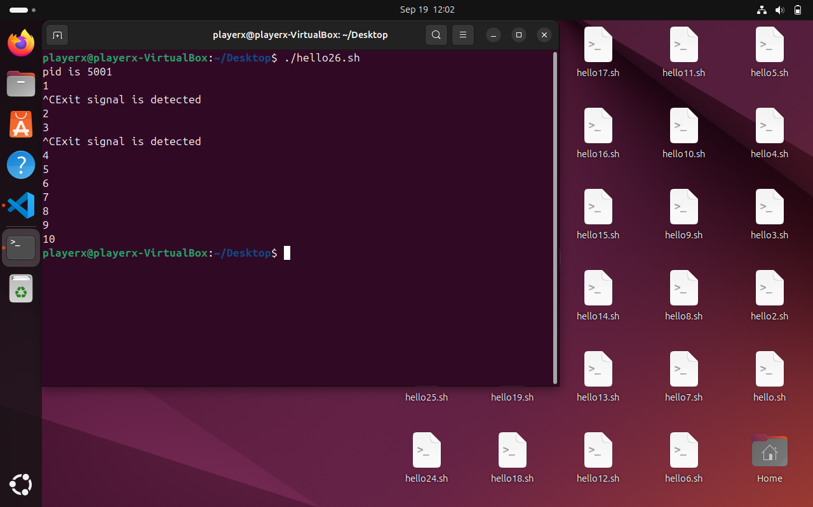
Shell Scripting
Signals and Traps
Ctrl+c is for SIGINT signal
Ctrl+z is for suspending the signal
Traps cannot stop SIGKILL and SIGSTOP
We can use kill function also to kill an operation

Slide 19
THANK YOU

